Slide 1
Flex
The Pocket Sized Weightlifting Coach
Joe Murphy & Matt Demoy

Slide 2
What is the problem that Flex will solve?
There are many fitness apps but none of them fit a weightlifters needs

Slide 3
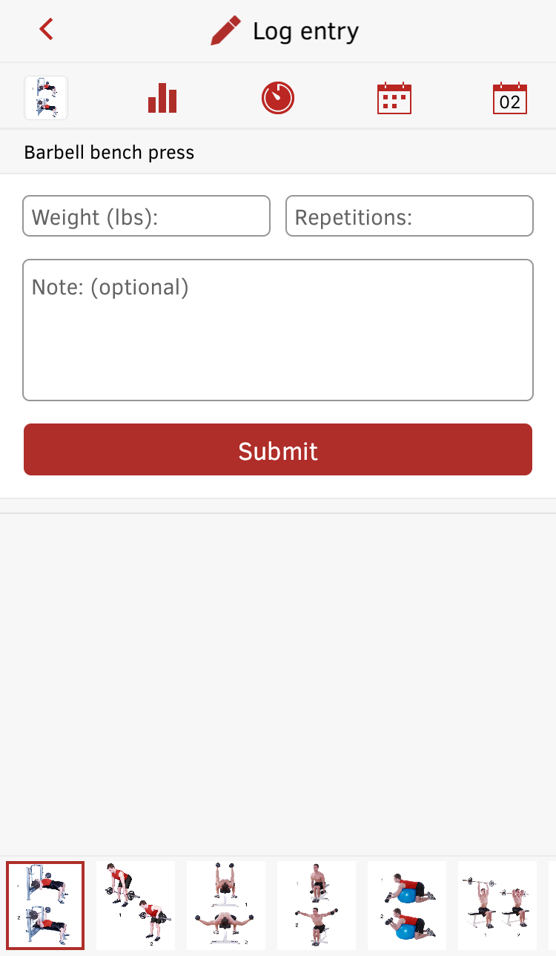

Issue #1 Logging lifts is too manual “Essentially Notes”
Allot of friction in the GUI
Full Fitness
#3 in Health and Fitness in the app store

Slide 4




Issue #2 - Horrible “endurance weightlifting” and extra workouts
Nike Training
Club

Slide 5
How does Flex solve this problem
Simple Gui that is helpful
Sticks to basic fundamentals of weightlifting rather than complicated rep schemes and splits.

Slide 6

So let’s check out the app and get READY TO FLEX
Vid Link Right Here

Slide 7
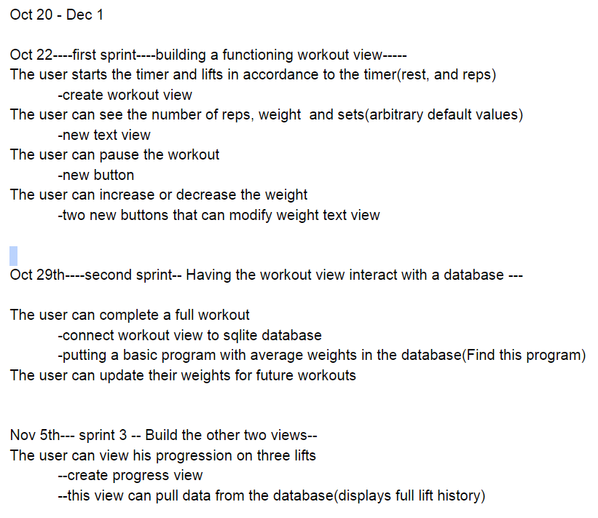
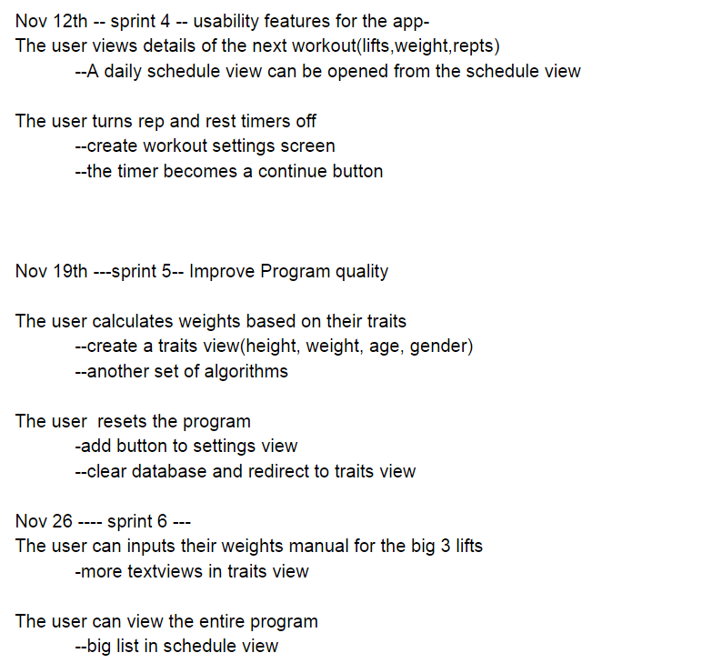
Design Timeline - User story driven features that were implemented weekly

Slide 8
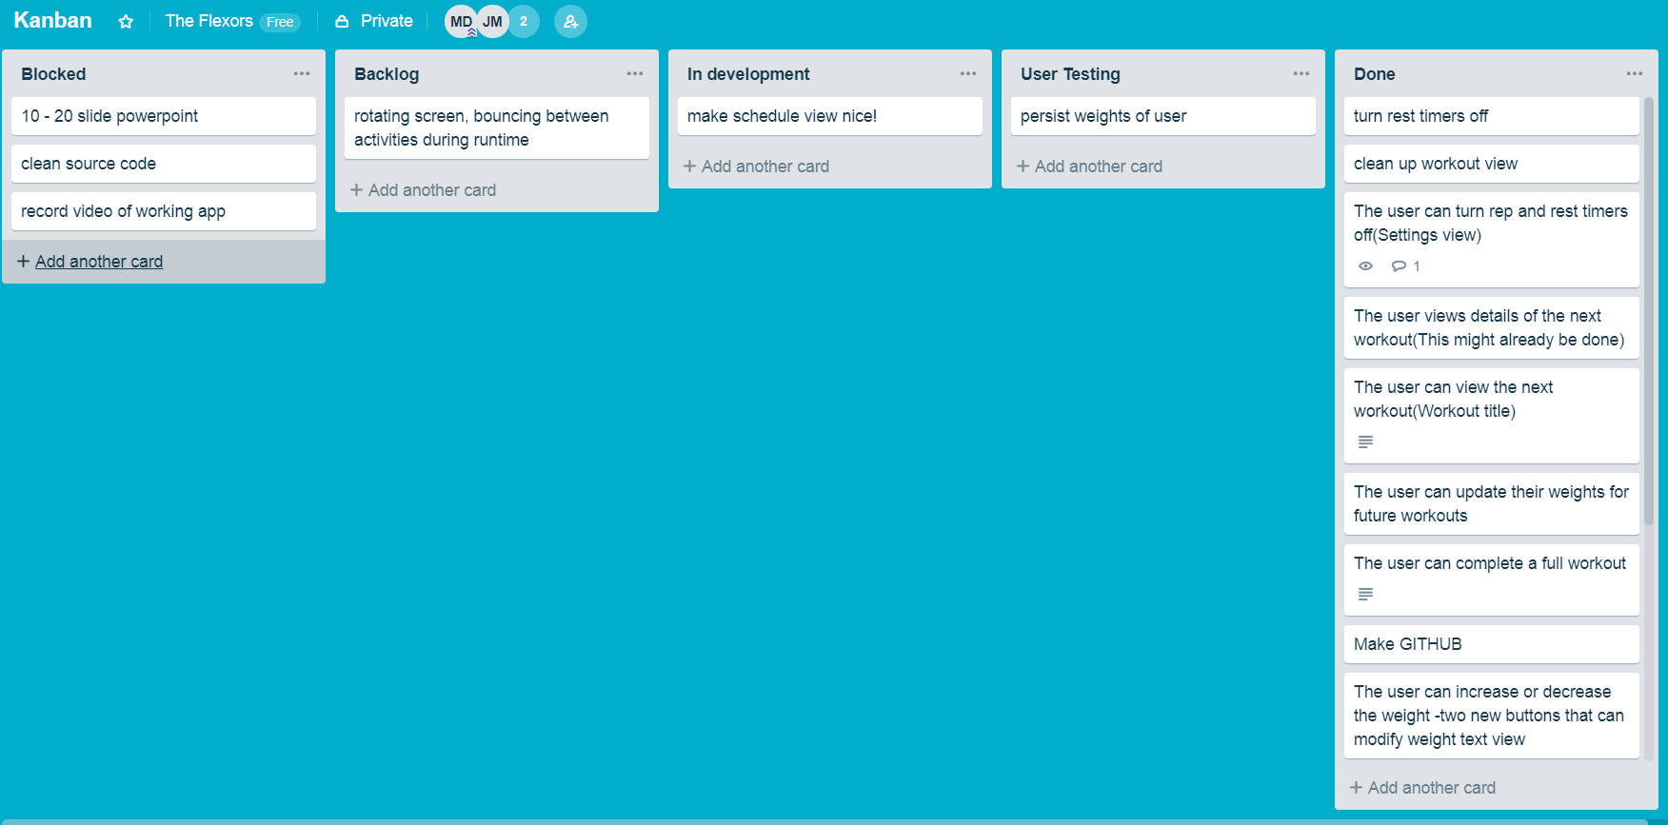
How we organized this project
Feature is in development
Quality Assurance
Every feature was tested by the other developer before being put in done
Ready to be implemented by one of the developers
Require other milestones to be met before being
ready to be implemented
Kanban/Scrum board made sure our app was always ready to ship regardless of which milestone of the project we were on.

Slide 9
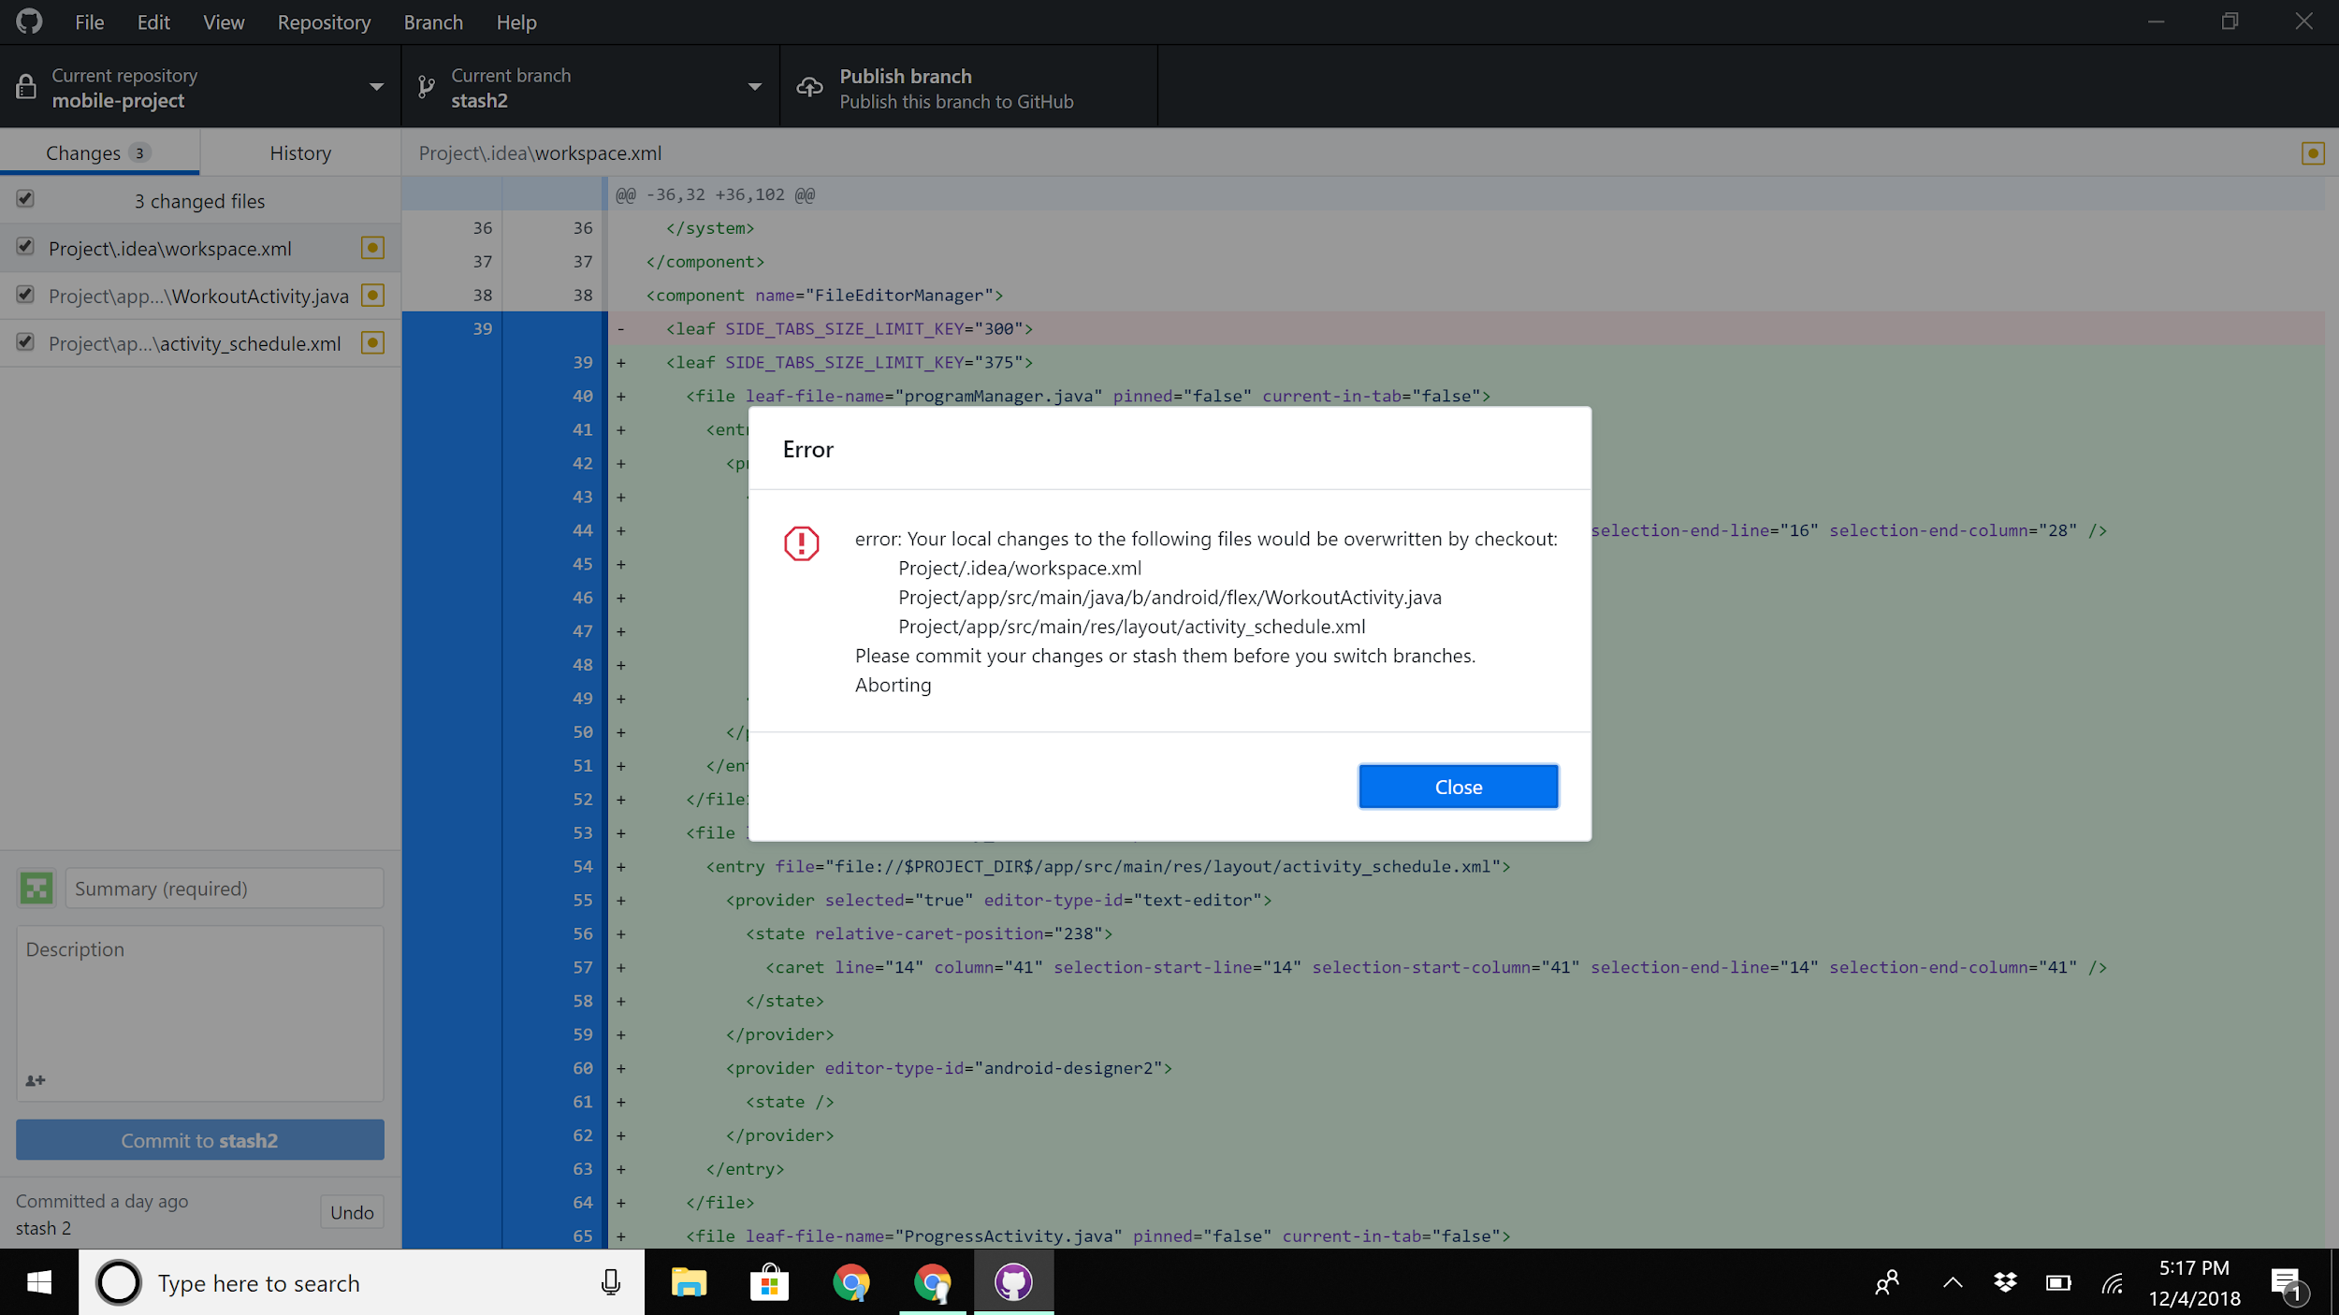
Problems with Github

Slide 10
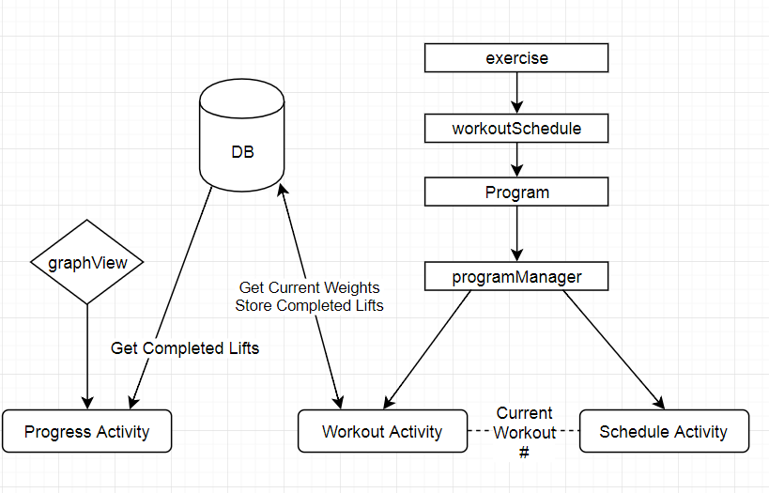
Here is the architecture

Slide 11
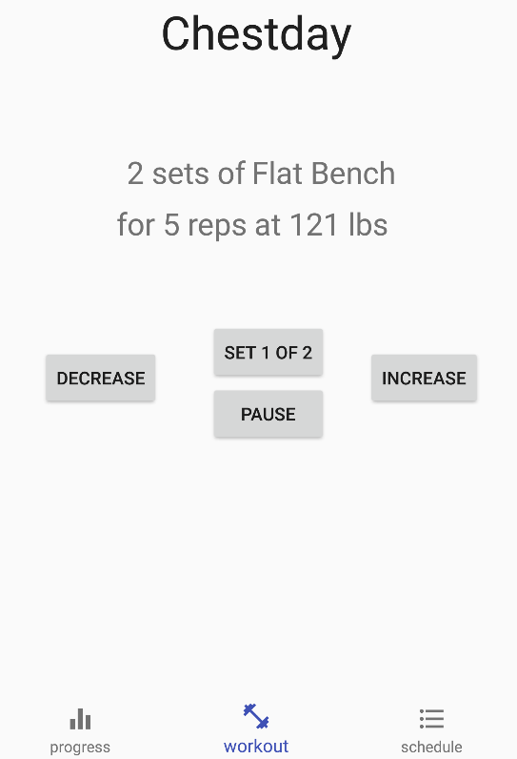
Workout Activity
Workout Title
“Go” Button
Continue With Workout,
Skip Rest Time,
Displays how many sets are left or rest time remaining
Exercise ViewGroup
Displays all info for the exercise in a single statement
Pause Button
Stops rest timer until further actions
In/decrease Button
Adjust the weights of the exercise.

Slide 12
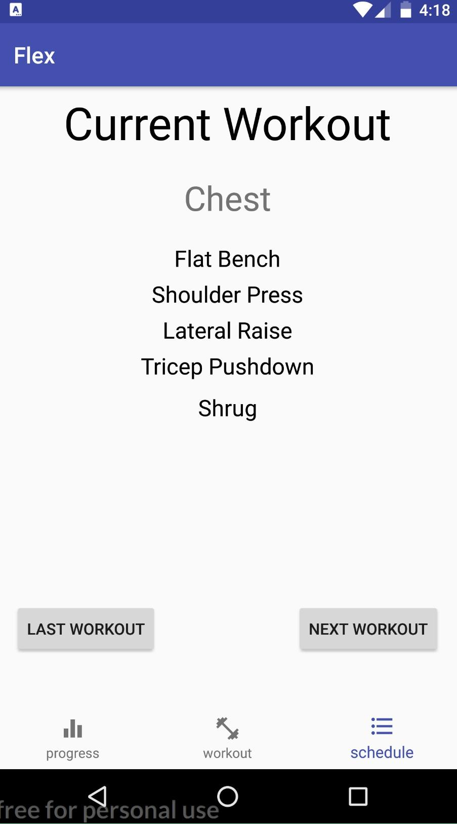
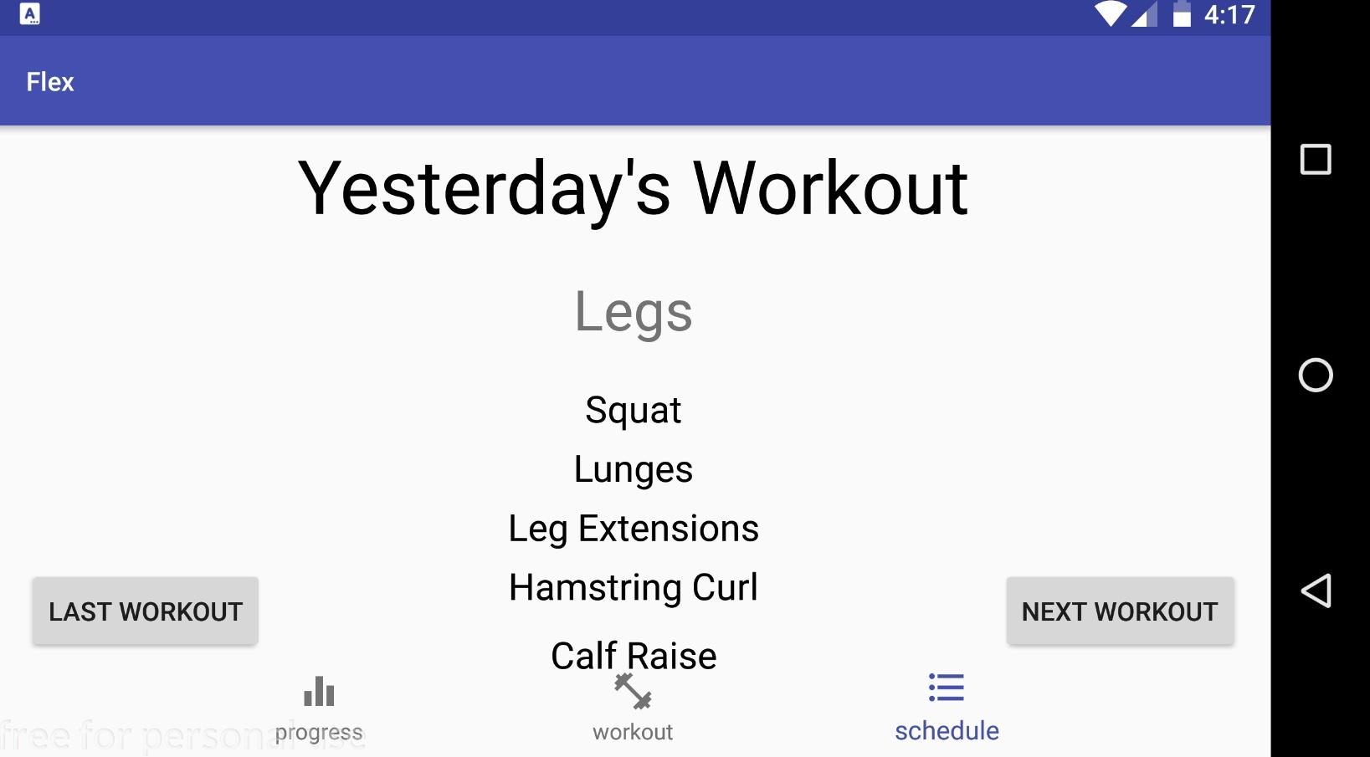
Schedule Activity
Shows what day it is
Horizontal View
Shows main workout type
List of day’s exercises and order
Shows next day’s workout
Shows previous day’s workout

Slide 13
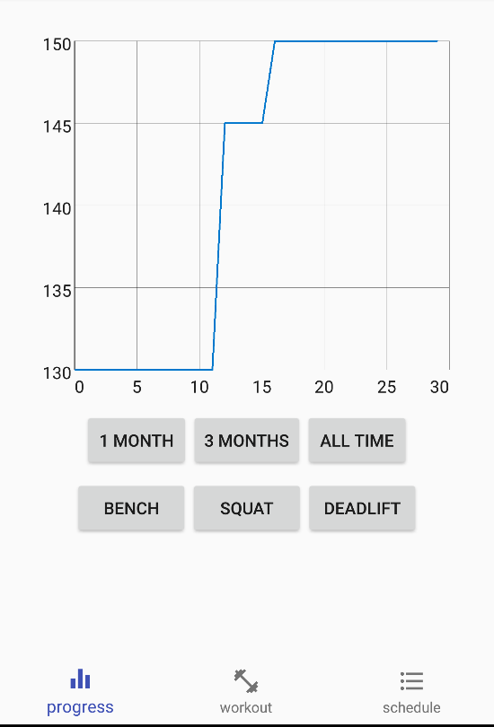
Progress View
GraphView
Easily see week to week progress
Weight In pounds
Timespan in days
Day/Weight ViewGroup
See progress on any combination of time and exercise

Slide 14
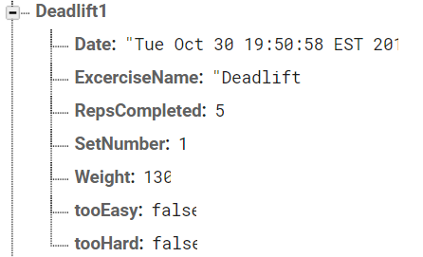
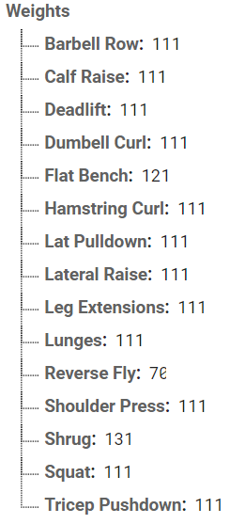
We don’t know SQL so we used Firebase
We stored completed exercises and the user’s weights

Slide 15
Thanks for listening any Qs?

